Slide 1

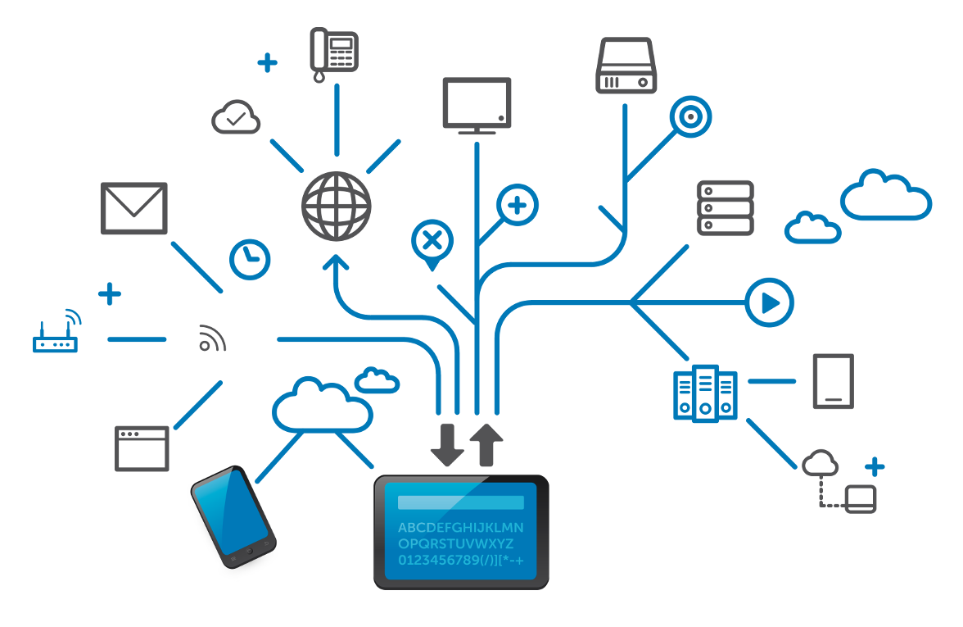
NETWORK FUNDAMENTALS
Notes:
O Logo de espadas deve ter mais espaço das pontas abaixo. Sugerir outros tipos de imagens/ telefone, fones.

Slide 2
Aastha Verma (152537)
Living in a network centric world
Communication over Network 1
Samiti Rahul (152907)
Communication over Network 2
Application layer protocols
Jabbireddy Gireesha (152659)
OSI Transport Layer
Network Layer
Naredla Gangavamshi (152851)
IPv4 addressing
Soumya Gupta (152915)
Data Link Layer
Physical Layer

Slide 3
Living in a network centric world
Notes:
O Logo de espadas deve ter mais espaço das pontas abaixo. Sugerir outros tipos de imagens/ telefone, fones.

Slide 4
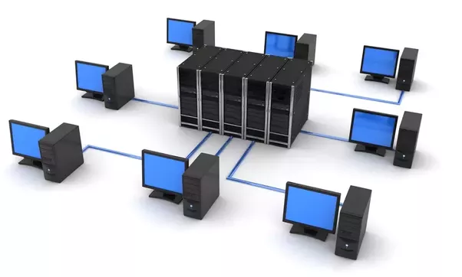
What is a Network ?
A computer network is a digital telecommunication network which allow nodes to share resources.

Slide 5

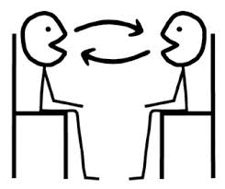



How network supports the way we LIVE ?
A

Slide 6

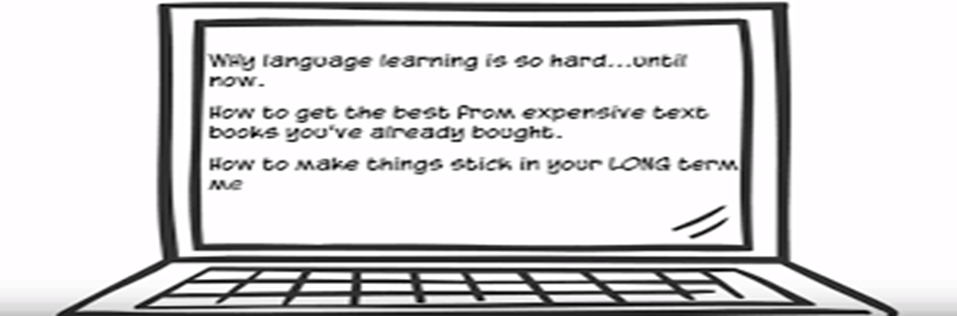
How network supports the way we LEARN ?
The Internet can enhance learning and makes it easier in several ways:
Distribution of content
Availability of various resources
Remote learning (enable learning to be done from any location)
E-learning - Courses delivered using Internet resources. Its benefits include:
Easy update of learning materials
Availability to a wide audience
Consistent quality of instruction

Slide 7

How network supports the way we WORK ?
Proper use of network can enhance communication between employees in an organization and also with external clients.
INTRANET :
A private network belonging to the company.
Allows communication between employees and also between branches.
EXTRANET :
A network to provide suppliers, vendors or customers, some limited access to corporate data.
Examples of common data to be shared: order status, inventory, parts lists.

Slide 8
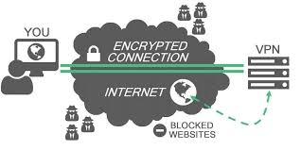
VPN (Virtual Private Network)
It allows employees to access company’s intranet remotely.
Work can be done even though the employee is outstation or at home.
Working from Home
No longer need to go to the office every day.
Communications with other employees or clients can be done online.
Can work and take care of family at the same time.

Slide 9
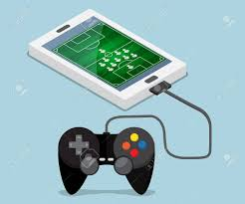

How network supports the way we PLAY ?
Entertainment is also enhanced by the use of network, say:
Chatting and instant messaging
Online interest groups
Web blogging
Video and audio streaming
Online games

Slide 10
Communication over Network

Slide 11
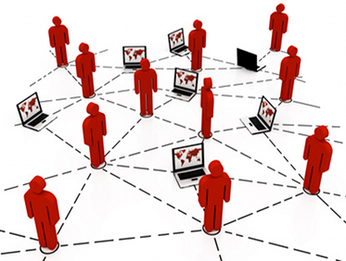
What is COMMUNICATION ?
Basic definition : means of sending or receiving information, by speaking, writing, or using some other medium.
Data Communication : Communication of digital data between a SOURCE and a RECEIVER via form of transmission media such as wired cable.
Protocols used in computer communication shares many similar concepts used in the protocol for human communication.

Slide 12
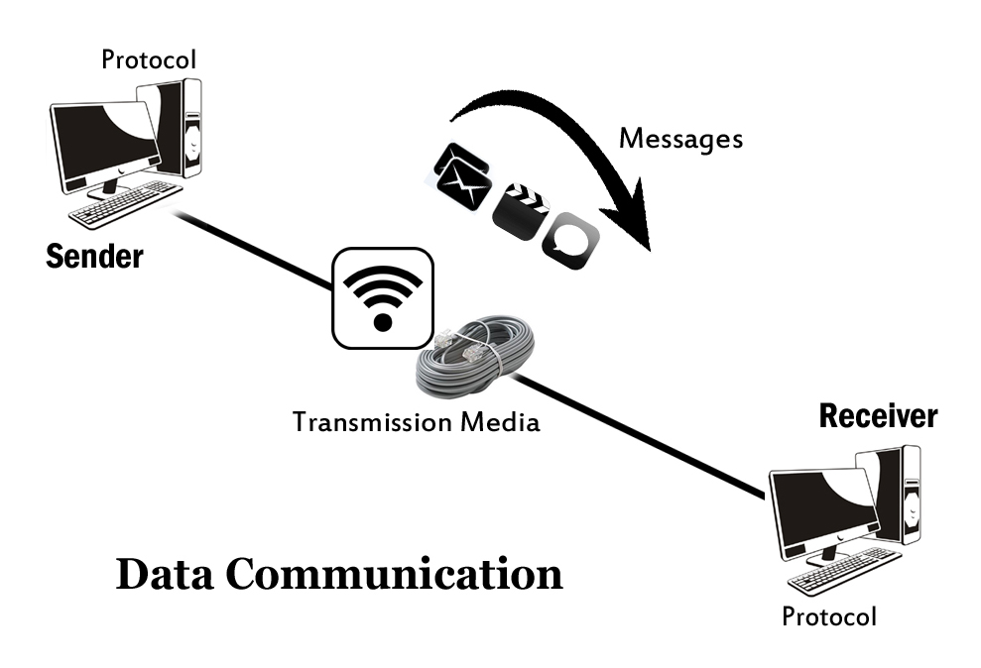
Elements of Data Communication
5 elements of communication:
Message
Sender
Receiver
Medium (Communication Channel)
Encoder & Decoder

Slide 13
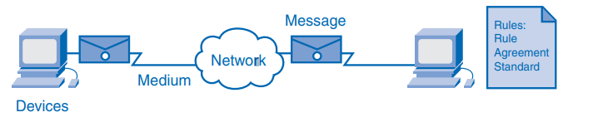
Elements of a Network
Traditionally, telephone, radio, television and computer data networks are four separate networks. Each has its own versions of the four basic elements.
Technology advances has allowed the four networks to be combined together.
This combined network is referred to as a converged network.
Voice, video and data can be carried over the same network.
Eliminate the needs to create and maintain separate networks.

Slide 14
Quality of Communication
Communication between individuals is determined to be successful when:
Meaning of message understood by recipient
Meaning of message intended by sender

Slide 15
Communicating over Networks
All networks have four basic elements in common:
Protocol
Rules that govern how the messages are sent, directed, received and interpreted.
The units of information that travels from one device to another over a medium.
Medium
Messages
Devices on the network that exchange messages to communicate with one another.
The way by which the devices are connected together.
Devices
Can be wired or wireless.

Slide 16
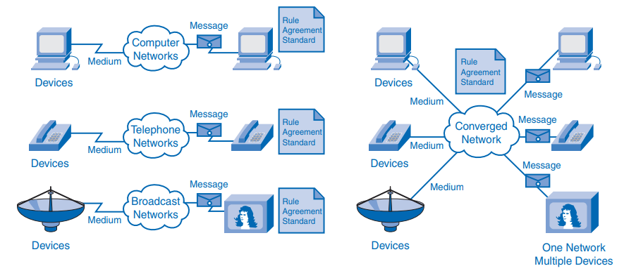
Converged Networks

Slide 17


Examples of today's popular communication tools
Intranet or Social Internet
Chat & Private Messaging
Discussion Forums
Tracking & Case Software
Internal Blogs

Slide 18

Advantages of Networks
Easy Communication and Speed -
Ability to Share Files, Data and Information
Sharing Hardware
Sharing Software
Security
Speed

Slide 19

Disadvantages of Networks
Breakdowns and Possible Loss of Resources
Expensive to Build
Security Threats
Bandwidth Issues

Slide 20
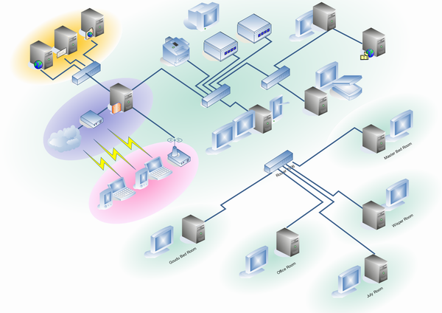
NETWORK DEVICES
Network devices are components used to connect computers or other electronic devices together so that they can share files or resources.
Network devices are also called Communicating devices.

Slide 21
Repeater
Function of a repeater is to receive incoming signals or data packets, regenerate the signals to their original strength and retransmit them.
Repeaters are used when we want to send signals over long distances.
Can also be used to reduce the impact of obstructions.
Repeaters basically repeats signals
Physical layer device

Slide 22
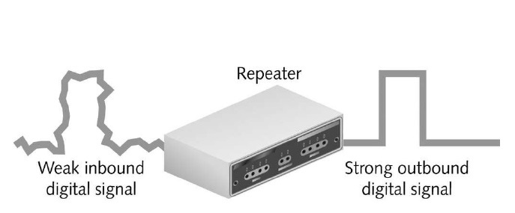
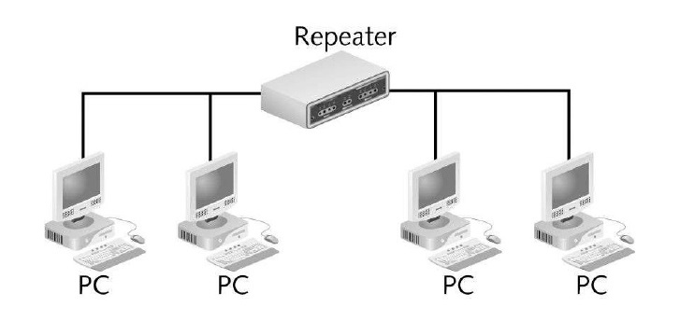

Slide 23
Bridge
Sometimes it is necessary to divide networks into subnets to reduce the amount of traffic on each larger subnet or for security reasons.
Once divided, the bridge connects the 2 subnets and manages the traffic flow between them.
Bridges examine the Media Access Control (MAC) address of each packet and forms a table.
Bridges operate at only Data Link Layer
Today, network switches have largely replaced bridges.

Slide 24
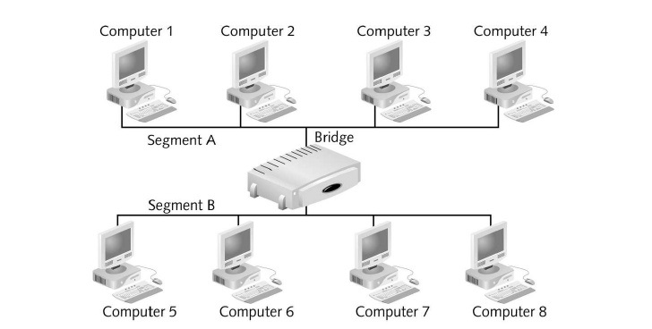
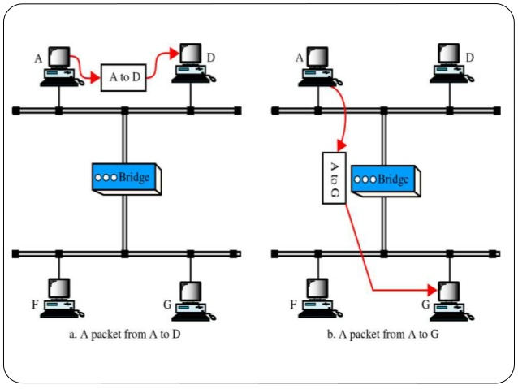

Slide 25
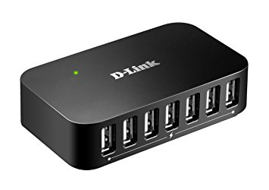
HUB
Hub is a networking device which is used to connect multiple hosts. It is the central point of connection.
Hub is basically a repeater in a star topology.
When a host sends a data packet to a network hub, the hub copies the data packet to all of its ports connected to. Like this, all the ports know about the data and the port for whom the packet is intended, claims the packet.

Slide 26
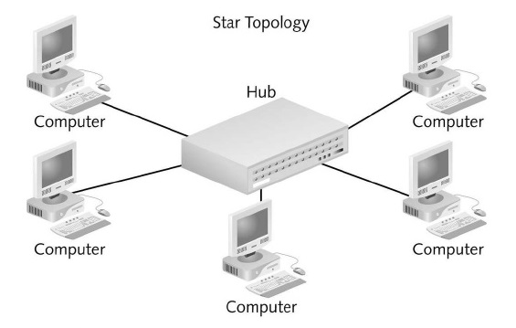
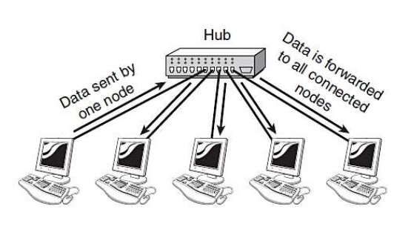

Slide 27
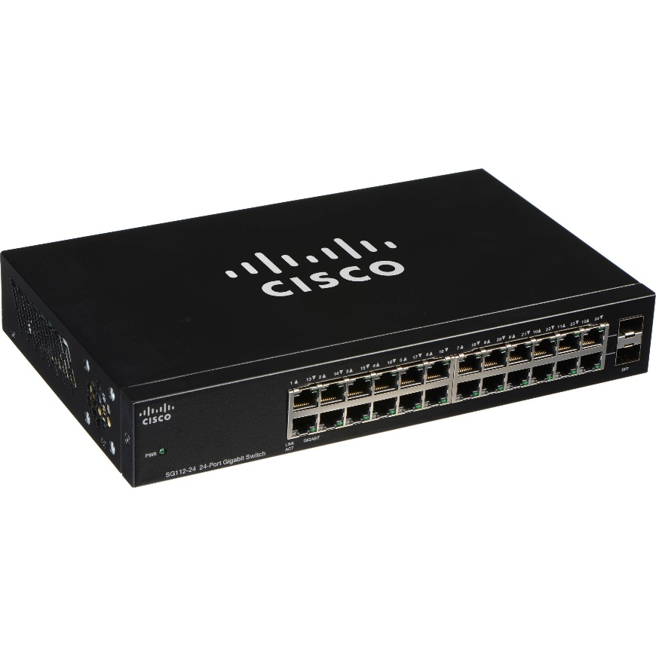
SWITCH
Like a hub, a switch also works at the layer of LAN but a switch is more intelligent than a hub. While hub just does the work of data forwarding, a switch does ‘filter and forwarding’ .
It forwards the data only to the destined device. When a frame arrives at a switch, the switch examines the destination address and forwards the frame out only to the necessary connection.
Operates at Data Link Layer

Slide 28
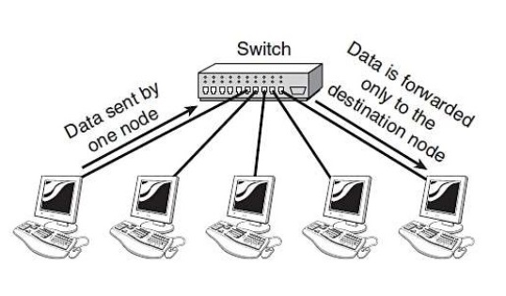

Slide 29
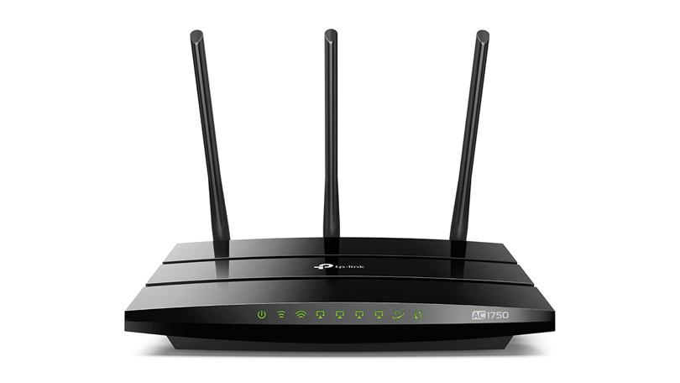
ROUTER
Router is a type of internetworking device.
Routers pass data packets between networks based on network protocol or layer 3 information.
Routers operate at the Network layer.
These devices router the data around the network and can make intelligent decisions to find the best route. They determine the shortest route to a destination and use it

Slide 30
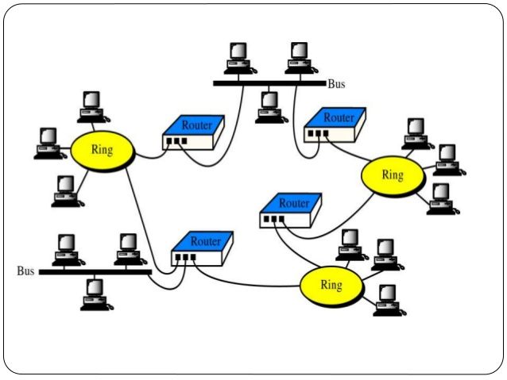

Slide 31
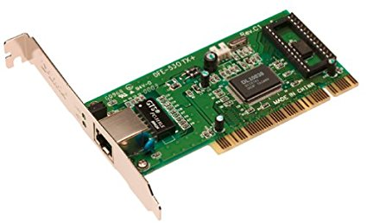
Network Interface Card (NIC)
NIC is a circuit board or card that is installed in a computer so that it can be connected to a network.
As the name suggests it is an interface between your computer and any other network our PC or system is connected to
It is also known as Ethernet card or Network adapter.

Slide 32
Network Architecture
Network Architecture refers to:
Technologies that support the network infrastructure.
Programmed services and protocols that move messages across that infrastructure.
Characteristics:
Fault tolerance
Scalability
Qualify of Service (QoS)

Slide 33
A Fault-tolerant Network Architecture
Fault-tolerance refers to the ability of the network to:
Limit the impact of hardware and software failures
Recover quickly when failure occurs
Before computer network is invented, the telephone network is already in existence. Telephone network is a circuit-switched, connection-oriented network.
A circuit is established before data transfer. This represents the path to be taken.
Resources are dedicated for each circuit – fixed data rate.
Any failure in the path may cause the connection to be terminated.
Has limited number of circuits. During peak periods, some calls may be denied.
Circuit stays active even if no one is speaking – inefficient use of resources.

Slide 34
Circuit-switching network is not very fault tolerant and can be costly (due to inefficient use of network resources).
Fault-tolerance can be improved by using a packet-switched, connectionless network.
A single message is broken into multiple message blocks called packets.
Packet contains address information of the sender and receiver.
No path needs to be established before data transmission (connectionless).
Different packets belonging to the same message can be sent through the network along various paths.
The original message will be reassembled once all the packets arrive at the receiver.

Slide 35
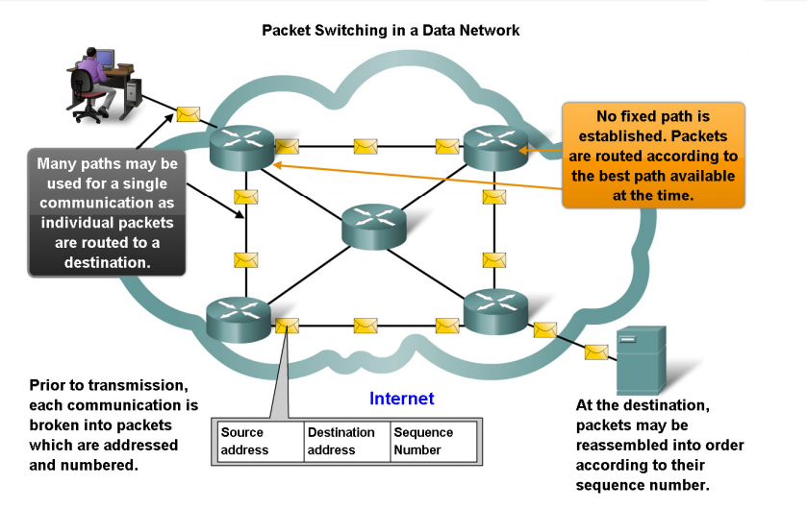

Slide 36

A Scalable Network Architecture
Scalability refers to the ability of the network to expand quickly to support new users and applications without impacting the performance of the service being delivered to existing users.
The Internet architecture is scalable due to the following characteristics:
It has a hierarchical layered structure for addressing, naming and connectivity service.
It uses common standards and protocols.

Slide 37
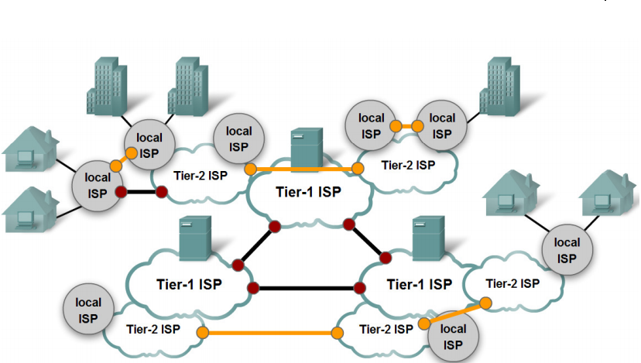

Slide 38

Providing Quality of Service (QoS)
QoS indicates the performance level of the services offered through the network.
The key concept behind providing QoS is to manage the utilization of network resources.
Applications that have certain quality requirements
should be given more priority to use network resources.
In the situation where network resources are
not sufficient, low-priority packets can be delayed
or dropped.

Slide 39
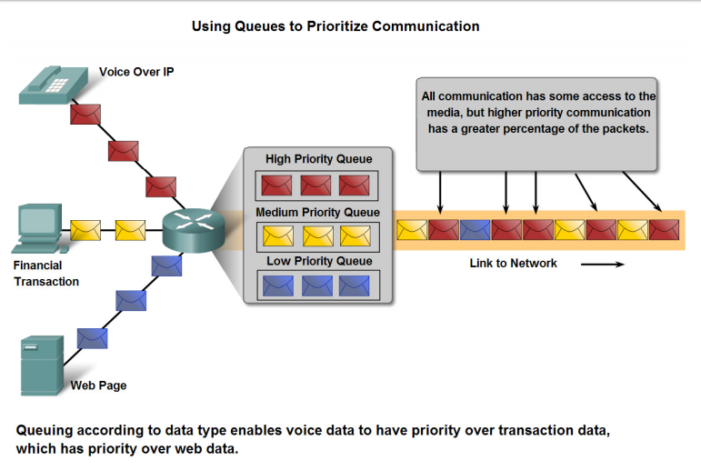

Slide 40
Providing Network Security
The Internet nowadays are used for exchanging confidential and business critical information.
Two types of network security concerns that must be addressed :
Network infrastructure security – physically securing the network devices and preventing unauthorized access.
Content security – protecting the information contained in the packets while being transmitted over the network and while being stored on network-attached devices.

Slide 41
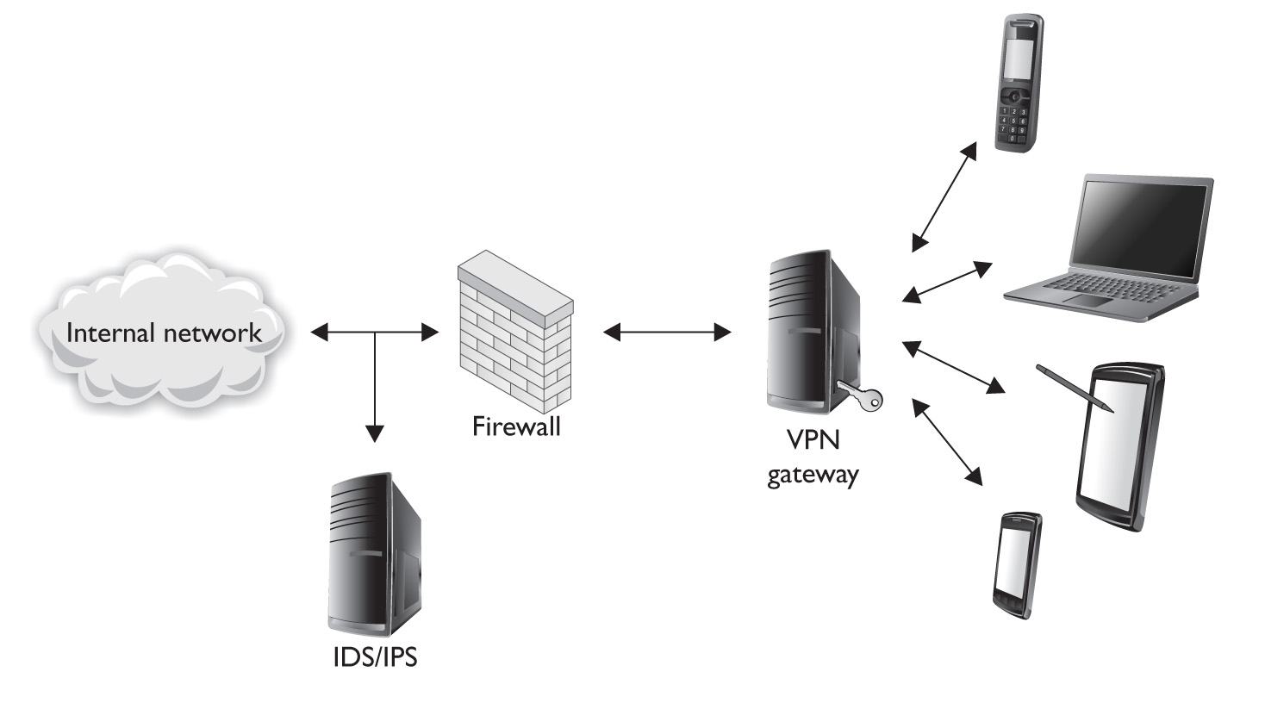
Security measures taken in a network should:
Prevent unauthorized disclosure or theft of information – ensuring confidentiality
Prevent unauthorized modification of information – ensuring integrity
Prevent denial-of-service (DoS) – ensuring availability

Slide 42
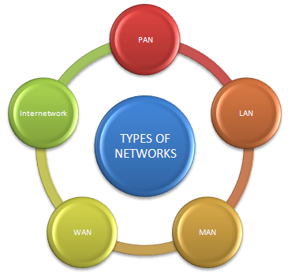

Slide 43
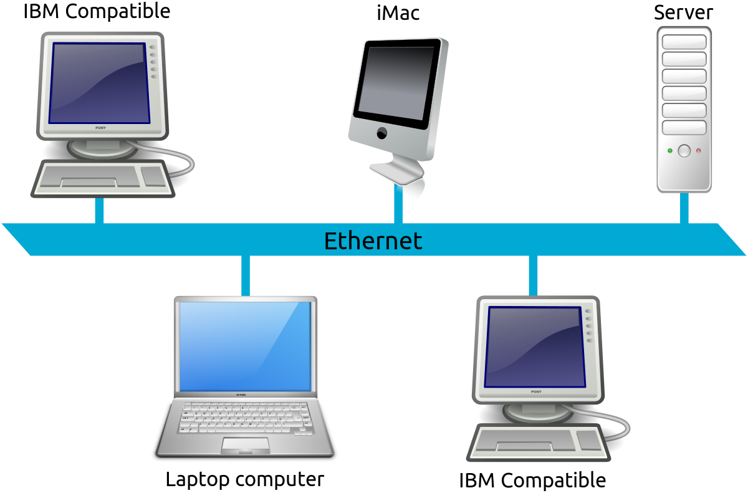
Local Area Network
A group of networks that share a common communication line or wireless link.
Connectivity is only for smaller area.

Slide 44
WIDE AREA NETWORK

Slide 45
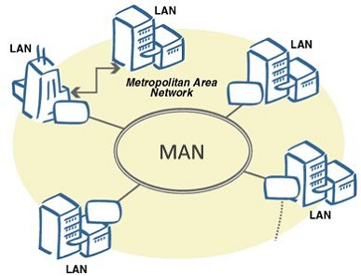
Metropolitan Area Network
Used to mean the interconnection of several local area networks by bridging them with backbone lines.

Slide 46
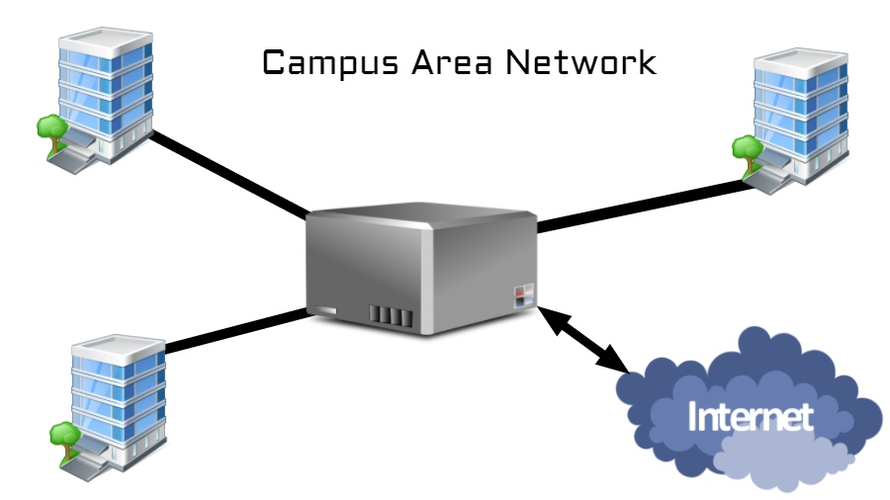
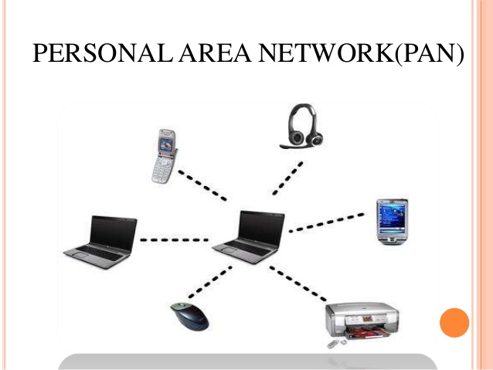
CAN
PAN

Slide 47
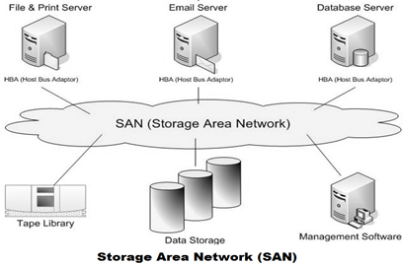
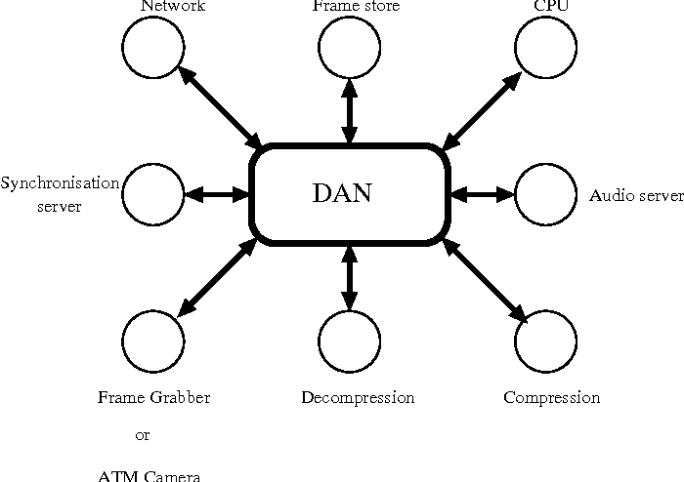
SAN
DAN

Slide 48
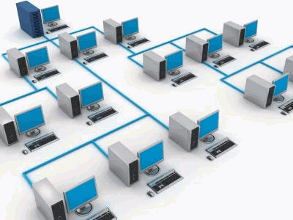
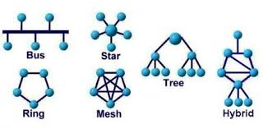
NETWORK TOPOLOGIES

Slide 49
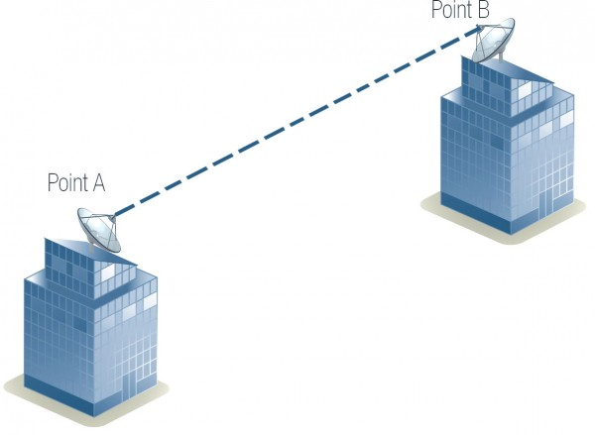
Physical Topology
Defines how the nodes of network is physically connected.
Types
Point-to-point
Simplest of all.
Two categories
Permanent Topology
Switched Topology

Slide 50
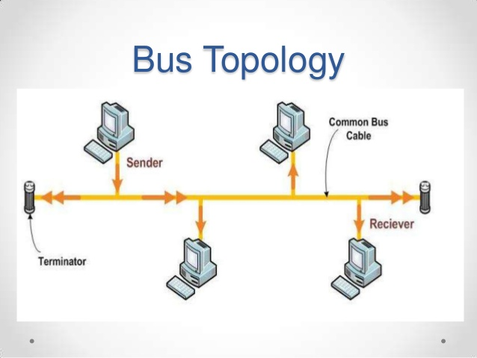
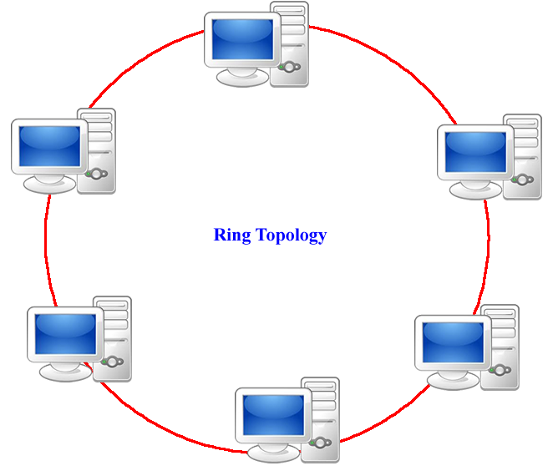

Slide 51
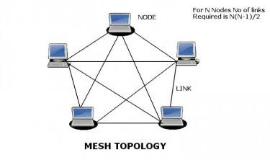
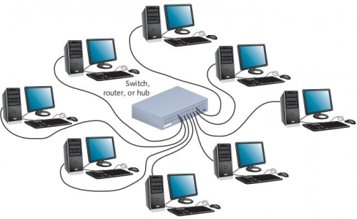
Star Topology

Slide 52
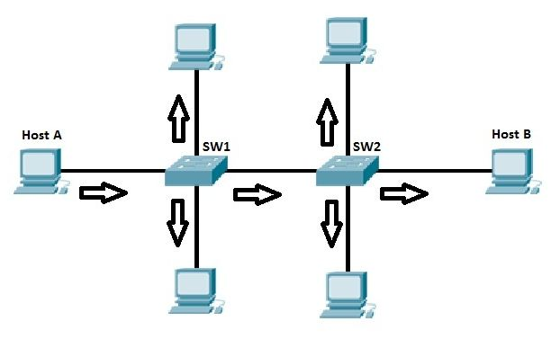
Logical Topology
Defines how the data is transmitted between the nodes.
Types
Broadcast topology
A method of transferring a message to all recipients simultaneously.
All-to-All communication.

Slide 53
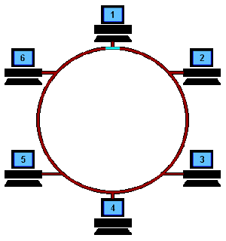
Token Passing
A channel access method where a signal called a token is passed between nodes to authorize that node to communicate.
A token is a 24-bit packet that circulates throughout the network from NIC to NIC in an orderly fashion.

Slide 54
Application layer protocols

Slide 55
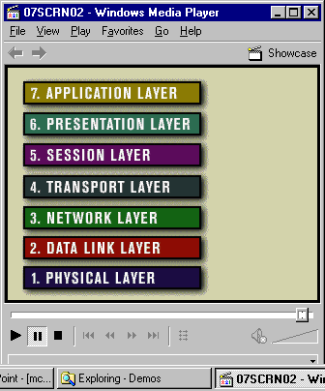
Layer of Models
TCP/IP 4-layers
OSI 7-layers
Application
Transport
Network
Network Interface

Slide 56
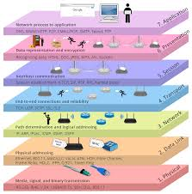
OSI Models
Open Systems Interconnection (OSI) is a set of internationally recognized, non-proprietary standards for networking and for operating system involved in networking functions.
Layers
7. Application Layer
6. Presentation Layer
5. Session Layer
4. Transport Layer
3. Network Layer
2. Data Link Layer
1. Physical Layer

Slide 57
LAYER 7 – The APPLICATION Layer
The top layer of the OSI model.
Provides a set of interfaces for sending and receiving applications and to use network services, such as: message handling and database query processing.
Responsibility: Providing services to the user.

Slide 58
LAYER 6 – The PRESENTATION Layer
Manages data-format information for networked communications (the network’s translator).
For outgoing messages, it converts data into a generic format for network transmission; for incoming messages, it converts data from the generic network format to a format.
Responsible: for certain protocol conversions, data encryption/decryption, or data compression/decompression.
A special software facility called a “redirector” operates at this layer to determine if a request is network related on not and forward network-related requests to an appropriate network resource

Slide 59
LAYER 5 – The SESSION Layer
Enables two networked resources to hold ongoing communications (called a session) across a network.
Applications on either end of the session are able to ex hange data for the duration of the session.
Responsible:
For initiating, maintaining and terminating sessions.
For security and access control to session information (via session participant identification).
For synchronization services, and for checkpoint services

Slide 60
LAYER 4 – The TRANSPORT Layer
Manages the transmission of data across a network.
Provides acknowledgements of successful transmissions and requests resends for packets which arrive with errors.
Responsible for the delivery of a message from one process to another.

Slide 61
LAYER 3 – The NETWORK Layer
Handles addressing messages for delivery, as well as translating logical network addresses and names into their physical counterparts.
Responsible for deciding how to route transmissions between computers.
Handles the decisions needed to get data from one point to the next point along a network path.

Slide 62
LAYER 2 – The DATA LINK Layer
Handles special data frames (packets) between the Network layer and the Physical layer.
At the receiving end, this layer packages raw data from the physical layer into data frames for delivery to the Network layer.
At the sending end this layer handles conversion of data into raw formats that can be handled by the Physical Layer.

Slide 63
LAYER 1 – The PHYSICAL Layer
The bottom layer of the OSI model.
Manages the interface between the the computer and the network medium.
This layer tells the driver software for the MAU what needs to be sent across the medium.
For outgoing messages: Converts bits into electronic signals.
For incoming messages: Converts electronic signals into bits.
Responsible: For movements of individual bits from one hop (node) to the next.

Slide 64
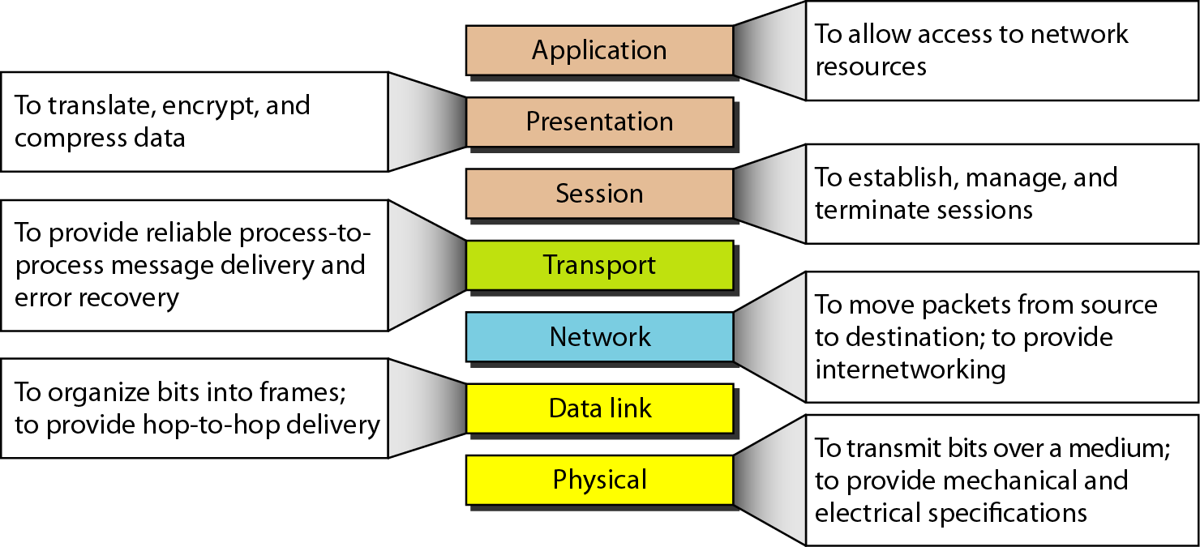
Summary

Slide 65
TCP/IP
Transmission Control Protocol/Internet Protocol.
It is the language a computer uses to access the internet. It consists of a suite of protocols designed to establish a network of networks to provide a host with access to the internet.
Layers
1. Application Layer
2. Transport Layer
3. Network Layer
4. Data link & Physical Layer.

Slide 66
Layer-1 Application Layer
Defines the rules when implementing specific network applications.
Rely on the underlying layers to provide accurate and efficient data delivery.
Typical protocols:
FTP – File Transfer Protocol
For file transfer
Telnet – Remote terminal protocol
For remote login on any other computer on the network
SMTP – Simple Mail Transfer Protocol
For mail transfer
HTTP – Hypertext Transfer Protocol
For Web browsing

Slide 67
Layer-2 Transport Layer
Application
Transport
Network
Network Interface
Message
Segments
h
M
h
M
h
M

Slide 68
Layer-3 Network Layer
Application
Transport
Network
Network Interface
Message
Segments
h
M
h
M
h
M
h
h
M
h
h
M
h
h
M
Datagrams / Packets

Slide 69
Layer-4 Data Link and Physical Layers
Application
Transport
Network
Network Interface
Message
Segments
h
M
h
M
h
M
h
h
M
h
h
M
h
h
M
Packets
h
h
h
M
h
h
h
M
Frames

Slide 70
Application layer Functionality and protocols

Slide 71
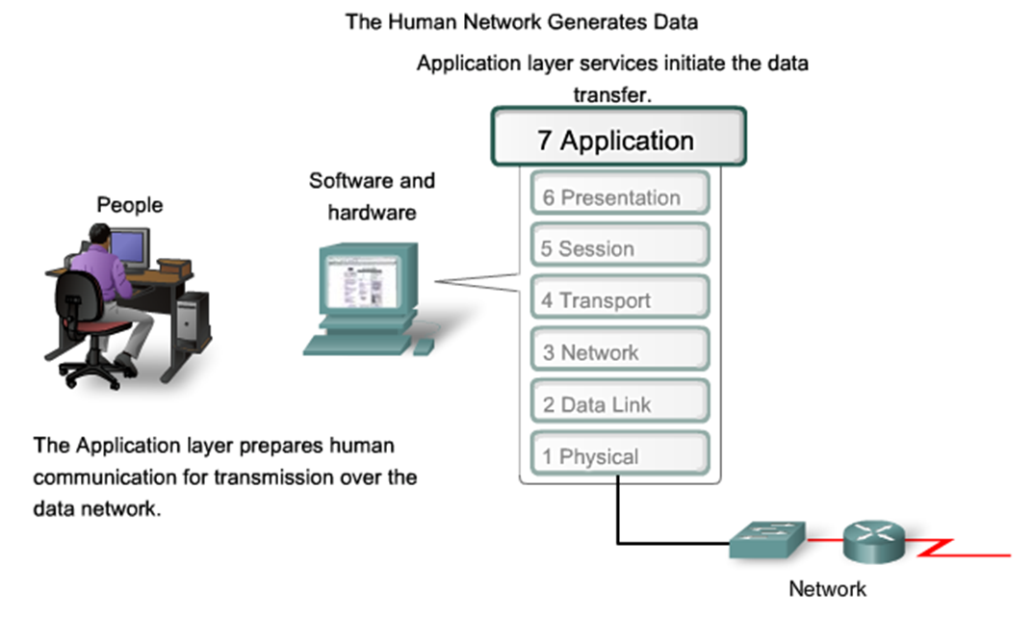
Interface between human and data networks
Explains that applications provide the means for generating and receiving data that can be transported on the network

Slide 72
The Application layer, Layer seven, is the top layer of both the OSI and TCP/IP models.
It provides the interface between the applications we use to communicate and the underlying network over which our messages are transmitted.
Application layer protocols are used to exchange data between programs running on the source and destination hosts.
There are many Application layer protocols and new protocols are always being developed

Slide 73
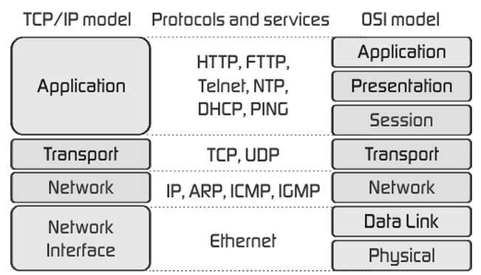
TCP/IP Application Layer Services
Explains the role of applications, services and protocols in converting communication to data that can be transferred across the data network

Slide 74
TCP/IP Application Layer Services
The most widely-known Application layer protocols are those that provide for the exchange of user information.
Domain Name Service Protocol (DNS)
Hypertext Transfer Protocol (HTTP)
Telnet, a terminal emulation protocol
File Transfer Protocol (FTP)

Slide 75
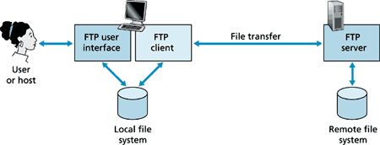
File Transfer Protocol (FTP)
File Transfer Protocol (FTP) is the commonly used protocol for exchanging files over the Internet. FTP uses the Internet's TCP/IP protocols to enable data transfer.
FTP uses a client-server architecture, often secured with SSL/TLS. FTP promotes sharing of files via remote computers with reliable and efficient data transfer

Slide 76
Advantages of FTP :
Allows you to transfer multiple files as well as directories
The ability to resume a transfer if the connection is lost
The ability to add items to a “queue” to be uploaded/downloaded
Many FTP clients have the ability to schedule transfers
No size limitation on single transfers (browsers only allow up to 2 GB)
Faster transfers then HTTP
Limitations of FTP:
Usernames, passwords and files are sent in clear text
Filtering active FTP connections is difficult on your local machine (passive is preferred)
Servers can be spoofed to send data to a random port on an unintended computer
Hard to script jobs

Slide 77

Trivial File Transfer Protocol (TFTP)
Trivial File Transfer Protocol (TFTP) is an Internet software utility for transferring files that is simpler to use than the File Transfer Protocol (FTP) but less capable.
It is used where user authentication and directory visibility are not required. TFTP uses the User Datagram Protocol (UDP) rather than the Transmission Control Protocol (TCP).

Slide 78
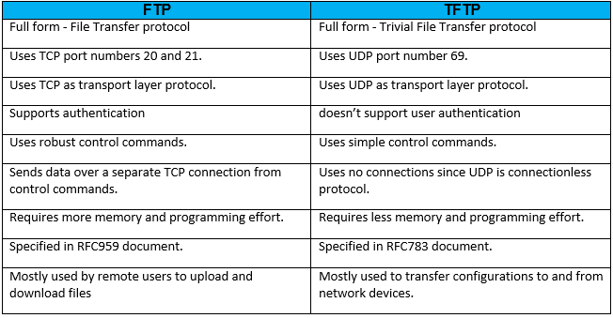
FTP vs. TFTP

Slide 79

HTTP means Hypertext Transfer Protocol. HTTP is the underlying protocol used by the World Wide Web and this protocol defines how messages are formatted and transmitted, and what actions Web servers and browsers should take in response to various commands.
HTTP is a Stateless Protocol
HTTP is a Stateless Protocol

Slide 80

HTTPS (HTTP over SSL or HTTP Secure) is the use of Secure Socket Layer (SSL) or Transport Layer Security (TLS) as a sub layer under regular HTTP application layering. HTTPS encrypts and decrypts user page requests as well as the pages that are returned by the Web server.
The use of HTTPS protects against eavesdropping and man-in-the-middle attacks. HTTPS was developed by Netscape.

Slide 81


Slide 82

NTP- Network Time Protocol
NTP stands for Network Time Protocol, and it is an Internet protocol used to synchronize the clocks of computers to some time reference.
The protocol is usually described in terms of a client-server model, but can as easily be used in peer-to-peer relationships where both peers consider the other to be a potential time source.

Slide 83
POP3 & IMAP
POP3 (Post Office Protocol 3) is the most recent version of a standard protocol for receiving e-mail.
POP3 is a client/server protocol in which e-mail is received and held for you by your Internet server.
Periodically, you (or your client e-mail receiver) check your mail-box on the server and download any mail, probably using POP3.
POP3 is designed to delete mail on the server as soon as the user has downloaded it.

Slide 84

IMAP in computing, the Internet Message Access Protocol (IMAP) is an Internet standard protocol used by email clients to retrieve email messages from a mail server over a TCP/IP connection.
The IMAP architecture enables users to send and receive emails through a remote server, without support from a particular device.

Slide 85

Email is emerging as the one of the most valuable service in internet today.
Most of the internet systems use SMTP as a method to transfer mail from one user to another. SMTP is a push protocol and is used to send the mail whereas POP (post office protocol) or IMAP (internet message access protocol) are used to retrieve those mails at the receiver’s side.
SMTP

Slide 86
SMTP Protocol
The SMTP model is of two type :
End-to- end method
Store-and- forward method
SMTP limitations:
It is useful for simplicity.
Transmission of executable files and binary files using SMTP protocol is not possible without converting it into text files.
It cannot transmit text data that contains national language.
It is limited to 7 bits ASCII characters only.
SMTP servers may reject mail messages beyond some specific length

Slide 87

DHCP and DNS
DHCP stands for Dynamic Host Configuration Protocol and is a network protocol via which a client can request an IP configuration and in turn be assigned one by a DHCP server.
Instead, the client itself communicates with the server and procures all the necessary parameters such as the IP address, network mask, and gateway independently.
DNS stands for Domain Name System and its function can be compared to that of a telephone directory. Network devices maintain one or more IP addresses, which are either statically configured or assigned via DHCP.
However, it is very difficult for people to remember IP addresses
– in contrast to easily pronounceable domain names such as “www.univention.com”.

Slide 88

TELNET
Telnet (TN) is a networking protocol and software program used to access remote computers and terminals over the Internet or a TCP/IP computer network. Telnet was conceived in 1969 and standardized as one of the first Internet standards by the Internet Engineering Task Force (IETF).
Typically, this protocol is used to establish a
connection to Transmission Control Protocol (TCP) port number 23

Slide 89

Secure Socket Shell
SSH, also known as Secure Socket Shell, is a network protocol that provides administrators with a secure way to access a remote computer.
Secure Shell provides strong authentication and secure encrypted data communications between two computers connecting over an insecure network such as the Internet.

Slide 90

Simple Network Management Protocol - SNMP
Simple Network Management Protocol (SNMP) is an Internet Standard protocol for collecting and organizing information about managed devices on IP networks and for modifying that information to change device behavior.

Slide 91

SIP & RTP
Session Initiation Protocol (SIP) is a signaling protocol used for initiating, maintaining, modifying and terminating real-time sessions that involve video, voice, messaging and other communications applications and services between two or more endpoints on IP networks.

Slide 92

Real-Time Transport Protocol (RTP) is an Internet Protocol standard that specifies the way programs manage the real-time transmission of multimedia data over unicast or multicast network services.

Slide 93

TLS
Transport layer security (TLS) is a protocol that provides communication security between client/server applications that communicate with each other over the Internet.
It enables privacy, integrity and protection for the data that's transmitted between different nodes on the Internet. TLS is a successor to the secure socket layer (SSL) protocol.
TLS protocol consists of two different
layers of sub-protocols:
TLS Handshake Protocol
TLS Record Protocol
TLS

Slide 94

Testing the Network Layer
Ping Command: It helps to verify the IP connectivity when troubleshooting.
Go to Win+R => CMD and type ping example.com

Slide 95
Traceroute Command:
Traceroute is used to diagnose network routing issues.
When you connect to another computer, your traffic does not go directly to the machine you are attempting to connect to.
Instead it goes through multiple machines on the Internet known as routers. These machines serve the sole purpose of controlling how your traffic gets to your destination.
If any one connection fails, you will not be able to connect to the intended destination.
The purpose of this utility is to show you the path your traffic takes when you are attempting to connect to another machine.

Slide 96

Traceroute Practical :
click Start
on the search type CMD
Once you have your Terminal box open

Slide 97

Internet Control Message Protocol (ICMP)
Internet Control Message Protocol (ICMP) is a TCP/IP network layer protocol that provides troubleshooting, control and error message
ICMP is most frequently used in operating systems for networked computers, where it transmits error messages.
Internet Control Message Protocol is also known as RFC 792.

Slide 98
OSI Transport Layer
Notes:
O Logo de espadas deve ter mais espaço das pontas abaixo. Sugerir outros tipos de imagens/ telefone, fones.

Slide 99

Transport layer roles & services:
Heart of OSI
Segmenting data/ Re assembling segments
Handles errors and data losses.
Protocols: TCP, SPX, NETBIOS, ATP ,NWLINK.
Network devices: Router, Gateway

Slide 100
Port address & Port number
An address is needed to choose among multiple processes running on the destination host called Port Number.
It is a 16 bit unsigned integer ranging from 0-65535.
Port number range | Port group
0-1023 | Well known ports
1024-49151 | Registered ports
49152-65535 | Dynamic ports

Slide 101

TCP and UDP

Slide 102
Differences between TCP and UDP
TCP
UDP
User Datagram Protocol
Slow
Reliable connection oriented(must be established prior to transmission)
Stream based data sent by the application with no particular structure.
Transmission Control Protocol
High speed
Un reliable [Connection less (data sent without setup)]
Message based data sent in discrete packages by application

Slide 103

Application and Operation of TCP Mechanisms
Transmission Control Protocol accepts data from a data stream, divides it into chunks, and adds a TCP header creating a TCP segment.

Slide 104


CONNECTION ESTABLISHMENT & TERMINATION

Slide 105

MANAGING TCP SESSIONS
TCP uses an end-to-end flow control protocol to avoid having the sender send data too fast for the TCP receiver to receive and process it reliably.
The final main aspect of TCP is congestion control.

Slide 106

TCP Retransmission
TCP will judge the need for a retransmission based on the RTO or the retransmission timeout. If the packet never receives an ACK in the time frame set, it's retransmitted.
The time between the two packets
is called the round-trip time.
Every time a retransmit happens,
the RTO for that packet doubles.

Slide 107
UDP protocol
The main characteristics of the UDP service are :
The UDP service cannot deliver SDUs that are larger than 65467 bytes
The UDP service does not guarantee the delivery of SDUs (losses and desquencing can occur)
The UDP service will not deliver a corrupted SDU to the destination

Slide 108

Process specified by the UDP protocol to reassemble PDUs at the destination device

Slide 109
Network layer

Slide 110

NETWORK LAYER
The layer that provides data routing paths for network communication. Data is transferred in the form of packets via logical network paths in an ordered format controlled by the Network layer.
Network layer mainly responsible for:
IP (Internet protocol)
Routing, which is moving packets
Other protocols include ICMP,
IPsec, ARP, RIP, OSPF and BGP.

Slide 111

Ipv4 and Ipv6
In fact, coexist with the older IPv4 for some time. IPv6 is designed to allow the Internet to grow steadily, both in terms of the number of hosts connected and the total amount of data traffic transmitted.

Slide 112

Ipv4 notation

Slide 113

Routing
Routers are devices that connect networks.
ROUTING is theprocess routers perform when receiving packets, analyzing the destination address information.
Using the address information to select a path for the packet, and then forwarding the packet on to the next router on the selected network.
Each route that a packet takes to reach
the next device is called a hop.

Slide 114
TYPES OF ROUTING
Static Routing
The route information can be manually configured on the router, creating what is known as a static route
Dynamic Routing
Routers can also learn about routes automatically from other routers in the same inter network, which is known as dynamic routing.

Slide 115

Packet forwarding
Routing is performed packet by packet and hop by hop. Each packet is treated independently by each router along the path.The router will then do one of the following with the packet:
■ Forward it to the next-hop router
■ Forward it to the destination host
■ Drop it

Slide 116

Default gateway
IP address of the interface on the router that connect to the network segment on which the source host is located.

Slide 117


Host Routing Table
Hosts require a local routing table to ensure that network layer packets are directed to the correct destination network.

Slide 118
IPv4 addressing
Notes:
O Logo de espadas deve ter mais espaço das pontas abaixo. Sugerir outros tipos de imagens/ telefone, fones.

Slide 119
IP Address
An IP address, short for Internet Protocol address, is an identifying number for a piece of network hardware.
Having an IP address allows a device to communicate with other devices over an IP-based network like the internet.
Internet Protocol version 4 (IPv4)
An IPv4 address is a 32-bit address that uniquely and universally defines the connection of a device (for example, a computer or a router) to the Internet.
Connectionless protocol
Fragments (divides) packets where necessary
Addressing via 32 bit Internet addresses
It is one of the core protocols of standards-based internetworking methods in the Internet, and was the first version deployed for production in the ARPANET in 1983

Slide 120

Octets
In computer and network technology, an octet represents any 8-bit quantity. Octets range in mathematical value from 0 to 255.
Octet strings are most commonly found in Internet protocol (IP) addressing , in which the 4 bytes of an IPv4 address consists of 4 octets. In dotted-decimal notation, an IP address appears as follows:
[ octet ] . [ octet ] . [ octet ] . [ octet ]

Slide 121


Decimal to Binary Conversion
Binary to Decimal Conversion
4215 = 1000001110111

Slide 122

Types of Communications
In ipv4 network host can communicate in three different ways :
Unicast –the process of sending a pocket from one host to an individual host
Broadcast- the process of sending a packet from one host to all the hosts in the network
Multicast – the process of sending a packet from one host to a selected group of hosts

Slide 123

Ipv4 address classes
There are 5 address class in ipv4
Class A
class A address uses 8 bits for the network Address and 24 bits for host addresses.
It as 128 networks and 16 million hosts.
The IP address start from 1.0.0.0 to 127.255.255.255
Ip address uses first octet for network address and remaining three octets for host addresses
Default subnet mask is 255.0.0.0

Slide 124

Class B
class B address uses 16 bits for the network Address and 16 bits for host addresses.
It as 16,382 networks and 65,534 hosts.
The IP address start from 128.0.0.0 to 191.255.255.255
Ip address uses first two octet for network address and remaining two octets for host addresses
Default subnet mask is 255.255.0.0

Slide 125

Class C
class C address uses 24 bits for the network Address and 8 bits for host addresses.
It as 2 million networks and 254 hosts.
The IP address start from 192.0.0.0 to 223.255.255.255
IP address uses first three octets for network address and last octet for host addresses
Default subnet mask is 255.255.255.0

Slide 126

Class D
The class D address class was created to enable mulcasting in an IP address.
A mulcasting address is a unique network address that directs packets with that destination address to predefined groups of IP addresses.
Therefore , a single station can simultaneously transmit a single stream of data to multiple recipients.
Range 224-239
1110
Host portion
Class E
These class address is used for only Research and Development.
Range 240-255
1111
Host portion

Slide 127
The IP address can be classify into two classes:
Public address: | Private Address:
This address considered as any valid address assigned to any user, and the organization who is responsible for registering IP ranges called Internet Service Providers (ISPs), and this address will be unique. | Any number or address assigned to a device on a private TCP/IP Local Area Network that is accessible only within the Local Area Network. RFC1918 designates three ranges of IP addresses as private: 10.0.0.0 through 10.255.255.255 172.16.0.0 through 172.31.255.255 192.168.0.0 through 192.168.255.255

Slide 128
Internet Protocol version 6 (ipv6)
Maintains good features of IPv4, discards bad ones.
• Not compatible with IPv4
• Compatible with all other Internet protocols including
TCP, UDP, ICMP, DNS, etc.
Main features:
Long addresses (128 bits) ⇒ supports billions of hosts.
Simplified, fixed size header ⇒ routers can process packets faster.
Support for authentication and privacy
Better support for type of service.

Slide 129
Addressing without Subnets
If we have a class B with a Flat Network, the number of host will be more than 216=65536 hosts, So the problem is here, that managing this network with this number of host is too tricky and the problems of this network will get down because of the heavy load. In other word, any single broadband can slowdown the network.
Therefore, the solution is the subnetting. Subnetting means divide or separate the single network into multiple networks that can reduce the loading from one network.
The advantage of using subnetting is:-
1. Reduce the traffic and the increase the performance.
2. The smaller network can easier to manage.

Slide 130
Subnet Mask
A mask is a 32-bit binary number that is expressed in dotted decimal notation. By default, a mask contains two fields, the network field and the host field. These correspond to the network number and the locally administered part of the network address. When an administrator subnets, they are adjusting the way they view the IP address.
Table 1: Default masks for classful addressing

Slide 131
Routers and hosts still assume class subnet masks by default:
Class A /8 255.0.0.0
Class B /16 255.255.0.0
Class C /24 255.255.255.0
The figure below gives an example to class C mask address:

Slide 132
Subnetting
Example: 192.168.1.0/26
here address start with 192 , so it is in class C .By seeing the first octet we can decide which it is.
Default subnet mask for class C is 255.255.255.0
in binary 11111111.11111111.11111111.00000000
/26 = 111111111.11111111.11111111.11000000
For 26 network bits we have borrowed two host bits as shown above
so now subnetting subnet mask will be 255.255.255.192
11111111.11111111.11111111.11000000
64 is the lower bit
26

Slide 133
11111111.11111111.11111111.11000000
No of subnet borrowed = 26-24(default class C)=2
No of Subnet Address =2^2 =4
No of host remaining =8 (default)-2 (subnet)= 6
No of Host Address possible =2^6=64
Network address | First host address | Last host address | Broadband address
192.168.1.0 | 192.168.1.1 | 192.168.1.62 | 192.168.1.63
192.168.1.64 | 192.168.1.65 | 192.168.1.126 | 192.168.1.127
192.168.1.128 | 192.168.1.129 | 192.168.1.190 | 192.168.1.191
192.168.1.192 | 192.168.1.193 | 192.168.1.254 | 192.168.1.255

Slide 135
Testing of network Layer
1) Write in command prompt ipconfig
There can be three errors
Error 1 : windows IP configuration (NIC disabled)
Error 2: Media state disconnected (physical cable is not connected
Error 3: APIPA (configure manual IP address given by the ISP
2) Ping to modem IP –if it is okay then
3) Ping to DNS IP –if connection between isp and pc also okay then
4) Ping to websites
5) Check the pc :Security setting ,proxy setting and Disable the Proxy

Slide 136
Data Link Layer
Notes:
O Logo de espadas deve ter mais espaço das pontas abaixo. Sugerir outros tipos de imagens/ telefone, fones.

Slide 137

Data link layer
The main task of data link layer are :
Transfer data from network layer of one machine to network layer of another machine using hop by hop transmission.
Convert the raw bit stream of physical layer into group of bits called “Frames”.

Slide 138

Sublayers of Data Link Layer
Data link layer has two sublayers :
Logical Link Control (LLC)
Media Access Control (MAC)

Slide 139
Logical Link Control (LLC)
Frames the network layer packet
Identifies the network layer packet
Media Access Control (MAC)
Addresses the frame
Marks the beginning and ending of the frame

Slide 140

Media Access Control (MAC)
Multiple Access Protocol
CSMA/CD (Carrier Sense Multiple Access/Collision Detection)

Slide 141
CSMA/CA ( Carrier Sense Multiple Access / Collision Avoidance)
It is protocol to prevent collision before they happen.
It checks the channel before transmiting the packet.
If the channel is clear, the packet is sent otherwise it waits for period of time and checks again if the channel is clear.
The period of time is called the backoff factor and counted down by a backoff counter.

Slide 142

Services of Data Link Layer
Flow Control : pacing between adjacent sending and receiving nodes.
Framing : Large block of data is converted into small frames. The frame contains 3 parts – Header, Data and Trailer
Error Detection : Error occurs due to change in bit during transmission or reception due to noise, signal attenuation etc. It is achieved by error detecting code that is function of bits being transmitted.
Error Correction : Capable of detecting and correcting the bit(s) error without resorting for transmission.

Slide 143
Protocols of data link layer
Address Resolution Protocol (ARP) – Each host has ARP table. It is used to find the MAC address of given IP address.
Asynchronous Transfer Mode (ATM) – It uses asynchronous TDM and encodes data into small, fixed size cells.
Point-to-Point Protocol (PPP) – It provides a standard method for transporting packets in the form of frames over peer-to-peer links.
High Level Data Link Control (HDLC) – It is bit oriented protocol used for error free transmission of data and control the speed at which data is transmitted.

Slide 144
Physical Layer
Notes:
O Logo de espadas deve ter mais espaço das pontas abaixo. Sugerir outros tipos de imagens/ telefone, fones.

Slide 145

Physical Layer
It is the lowest layer of the OSI reference model.
It is responsible for sending bits from one computer to another.
It deals with the setup of physical connection in the network and with transmission and reception of signals.

Slide 146
Functions of Physical Layer
Representation of bits
Data Rate
Synchronization
Interface
Line Configuration
Topologies
Transmission Modes

Slide 147
Services of Physical Layer
Bit-by-bit delivery.
Modulates the process of converting a signal from one form to another so that it can be transmitted.
Line coding, which allows data to be sent by hardware devices that are optimized for digital communications.
Circuit switching
Multiplexing
Carrier sensing and collision detection.
Signal equalization to ensure reliable connections and facilitate multiplexing.
Forward error correction such as error correction code.

Slide 148

The physical layer is also concerned with :
Bit rate – is the total number of physically transferred bits per second.
Point-to-point, multipoint or point-to-multipoint line configuration.
Serial or parallel communication - Simplex, half duplex or full duplex transmission mode.

Slide 149


